Slide 1
Mobile Security Solutions
Enabling MNOs to conform cost-efficiently to the growing homeland security requirements

Slide 2
About Us
Both WDS Mobile and Sicap are veterans of the device data and management space with almost a combined 60 years of serving the telecommunications industry.
We have a combined vision for providing seamless and secure connectivity across mobile, tablet, wearable, IoT and broadband devices, this consolidation combines the resources and expertise required to deliver exciting new capabilities to customers.
This bond of product strategies will provide the most in-depth device database on the market coupled with a broad range of Modules supporting Mobile, Broadband / IoT, and Subscribers.
This move helps leverage the strengths of different product lines and technologies to create more comprehensive solutions.
2024/03/15

Slide 3
Our Vision
We provide a seamless experience for subscribers of major Communication Service Providers.
We offer a range of capabilities covering Mobile, Tablets, Wearables, Broadband, IoT and Subscriber Management.
These enable operators to correctly detect, identify and configure subscriber devices, and perform analysis to highlight monetization & efficiency opportunities.
2024/03/15

Slide 4
Why Global CSPs work with us
Our unrivalled expertise coupled with a broad range of products enables our customers to:
Maintain Innovation Keep pace with technological advances in infrastructure and increasing customer expectations across an increasing set of devices and services
Maximize Profit Drive network utilization and subscriber monetization whilst lowering customer service calls to reduce costs and protect profit
Maintain Brand Reputation Delivering exceptional services, security and innovation drive exceptional customer experience in all interactions
2024/03/15

Slide 5
Our Customer & Presence
60+ Customers
20+ Countries
2Bn Daily Transactions
2024/03/15

Slide 6
Our Strengths
We ensure customers can utilize the services of the network to allow you to provide better services and drive more value.
As a stable supplier with unrivalled products & people, let us help you save money, realize revenue and improve brand perception by utilizing our:
Breadth of capability
Expertise around complexity
Broad range of solutions
Pre-integrated ecosystems
Ability to innovate rapidly with customers
2024/03/15

Slide 7
Our Partnerships
Our relationships with leading value-added resellers (VAR), manufacturers (OEM), and technology partners ensure we remain ahead of the curve and the products are ready for the future.
VAR Partnerships
OEM Partnerships
Technology Partnerships
2024/03/15

Slide 8
Delivering Seamless Experiences On Any Device
We are experts at delivering end-to-end integrated device solutions. We offer a suite of highly-focused solutions that can be taken individually or combined, all of which will deliver huge benefits to your business, both in terms of cost savings, customer satisfaction and retention.
Our product ecosystem creates a seamless customer experience for all devices connecting to your network and includes a range of Modules covering your Mobile, Broadband/IoT and Subscriber needs
Mobile & Wearables
Broadband & IoT
Subscriber Management
2024/03/15

Slide 9
Delivering Seamless Experiences On Any Device
These Modules enable operators to correctly detect, identify and provision devices attached to the network, perform deep analysis on the data generated and highlight potential Monetization opportunities for new revenue streams.
Detect
Act
Analyse
Monetise
Support
Identify devices and subscribers as soon as they join your network
Perform actions and manage connected devices to maximise network utilisation
Gain actionable insights from your network and device data generated by subscribers
Drive more and new revenue from opportunities across your services
Use our expertise in technical operations to allow you to focus on what matters most
2024/03/15

Slide 10
Portfolio Overview
 | Detect |  | Act |  | Analyse |  | Monetize |  | Support
Mobile & Wearables
Broadband & IoT
Subscriber Management
Automatic Device Detection
Auxiliary Data Connector
Advanced Device Management
Bulk APN Provisioning
Device Specification Database
Live Device Analytics
App Promotion
USSD Menu Browser
Testing-as-a-Service
Equipment Identity Register
Messaging Gateway
Device Entitlement Server
Homeland Security Enablement
Wearables Monetisation
Campaign Manager
Knowledge-as-a-Service
Broadband Device Detection
Broadband Device Management
Broadband Analytics
MAP Monetize
Managed Operations
Service
Assurance
IoT Device Detection
IoT Device Management
IoT Analytics
Managed
Cloud
NOC Shadowing
eSIM Management
Provisioning on-demand
Billing
Chatbot
SDK Self Care
Physical SIM Management
Mobile Money
Contact Centre as a Service
2024/03/15

Slide 11
Overview

Slide 12
How do we protect mobile subscribers?
The MNO needs a tool to track & check all devices, SIM cards & subscribers connected to the network, collaborate with authorities & take right decisions at the right time.
Subscribers (MSISDN)
SIM Cards (IMSI)
Devices (IMEI)
2024/03/15

Slide 13
Mobile Security Solutions
Enabling MNOs to conform cost-efficiently to the growing homeland security requirements and to protect subscribers, networks and brands against stolen and fraudulent mobile devices.
Equipment Identity Register (EIR)
Protect subscribers and network against stolen, fraudulent and malfunctioning mobile devices.
Safer Homeland Security Enablement through real-time device intelligence, big data and analytics.
2024/03/15

Slide 14
Safer

Slide 15
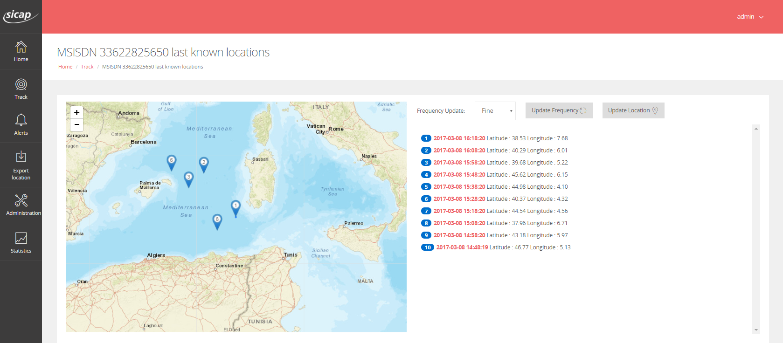
Safer - The Homeland Security Enabler
Cellular networks, devices and SIMs provide an ideal tool to monitor, trace and locate suspects .
Homeland security support requirements generate costs and consume working time for MNOs
Safer provides tracing, monitoring and locating devices, SIMs and subscribers, in real-time and back in time.
Safer is a secure, collaborative platform for various stake holders.
2024/03/15

Slide 16
Safer Benefits
Offer Better Support to Law Enforcement Authorities
Comply to Homeland Security Requirements
Lower Your Homeland Security Costs
2024/03/15

Slide 17
Key Functionality
Collect and Store Data
Safer collects and stores triplet (MSISDN, IMEI, IMSI) data from mobile devices and network including device location and device characteristics data.
Search and Locate
With Safer, users can search and locate devices and device owners in real-time, view location history, on a global map over several years.
Subscriber and Device Information
Provides access to view various properties of subscribers: Name, device changes, location history and number of subscribers in the neighborhood.
Alert Notifications
Automatic push alerts on SMS and email at configurable events such as device change, owner change, SIM change and location change.
2024/03/15

Slide 18
MNO Safer Platform Overview
Device
Management
System
Device Change
SAFER
DRS
Populate
(Device characteristics)
Location Base Server
Location
Change
SMSC
SMTP
EIR
DRS
SAFER
MNO
« Plug & Play » SAFER next to any
Device Management System & Location Server
2024/03/15

Slide 19
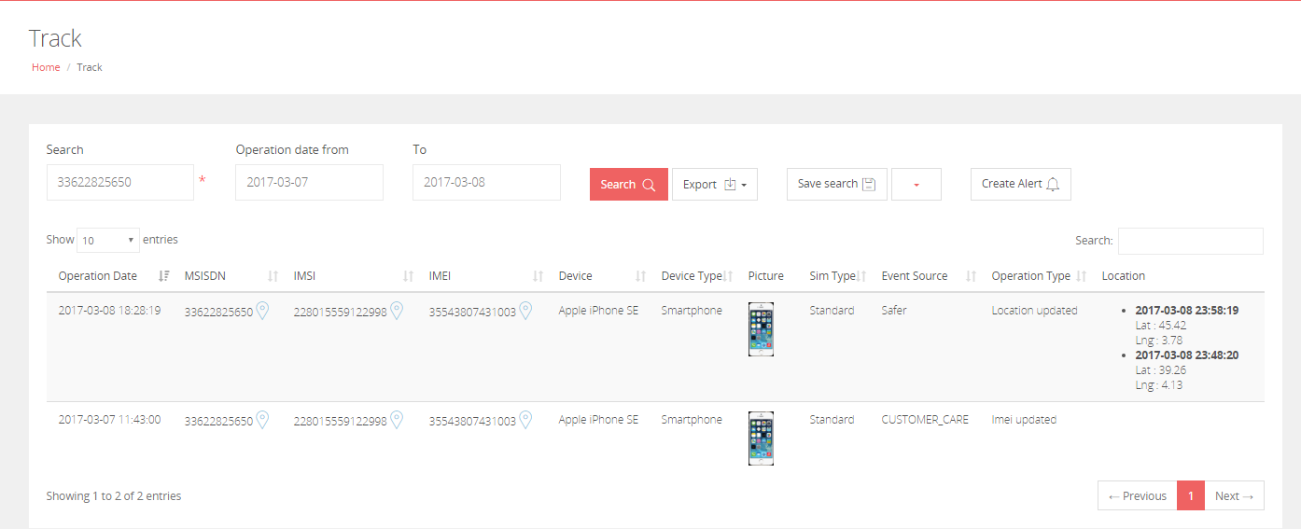
Search by MSISDN, IMSI or IMEI
2024/03/15

Slide 20
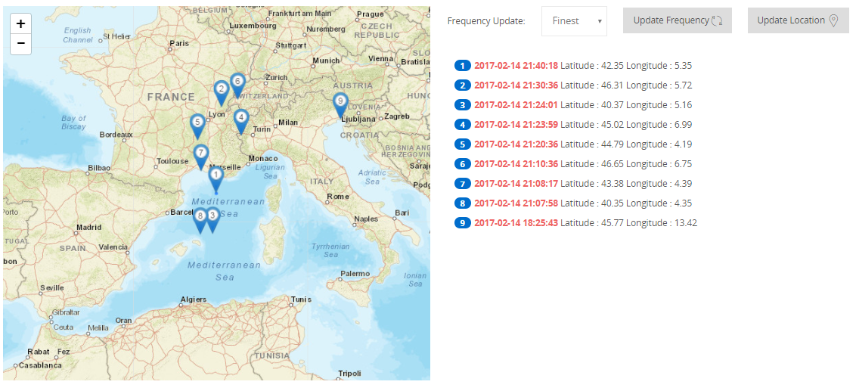
Location History on a Map
See on the map the location history for a long period (several years) by MSISDN, IMSI or IMEI.
Update location update frequency for specific MSISDN.
Get real-time the subscriber location.
2024/03/15

Slide 21
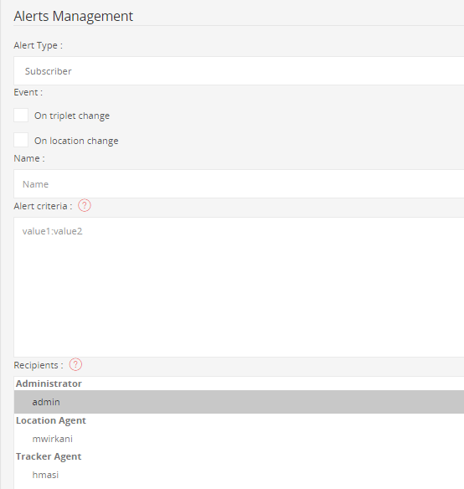
Alert Management
Define & Push Alerts by SMS & Email on triplet change, location change to any agent(regulator, Police authority, MNO).
Define & Push Alerts by SMS & Email on location update frequency & first consultation to any agent(regulator, Police authority, MNO).
2024/03/15

Slide 22
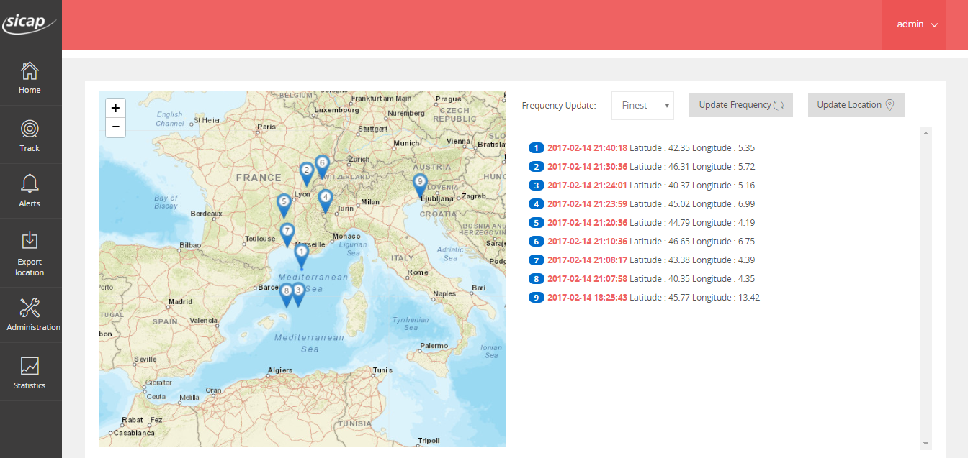
Safer Live Demo
2024/03/15

Slide 23
Equipment Identity Register (EIR)

Slide 24
Equipment Identity Register (EIR)
Our Equipment Identity Register is a fully standard compliant mobile network element
Protects subscribers and networks from fraudulent and stolen mobile devices
EIR admits or blocks a device to attach to a mobile network
OK!
Allow listed devices are attached to the network
Deny listed devices are blocked from the network
A device tries to attach a network
EIR checks if the device is Allow, Deny or Grey listed
2024/03/15

Slide 25
Key Functionality
2G, 3G and 4G/LTE Compatible
When connected to legacy networks EIR tracks MAP CHECK-IMEI messages
On 4G/LTE networks EIR integrates with the IMS network on the Diameter S13 interface.
Configurable White, Black and Grey Listing
A Grey-listed IMEI code can be processed as a deny-listed or grey-listed device, depending on how configured by the operator.
Central-EIR Integration
GSMA managed Central-EIR (C-EIR) is an international, centralized repository of IMEI statuses which operators are able to access to get deny-listed IMEI lists from other operators.
Interface for Remote Access
EIR provides REST and SOAP APIs to manage remotely the Allow, Grey and Deny lists.
2024/03/15

Slide 26
Architecture
DEVICE
Core Network
MSC
SIGTRAN MAP CHECK IMEI
EIR Back End
NewNet D7 Stack
SIMQ
SGSN
STG
PA-STG
EIR
Front
End
SFTP
Oracle DB Triplets B&G lists
MME
Diameter ECR
PA-Diameter
EIR In-memory B&G lists
SGSN
Central EIR
2024/03/15

Slide 27
Benefits
Protect Revenue and Brand by Avoiding Network Malfunctions and Security Breaches
Increase Customer Loyalty by Reducing the Value of Stolen Devices
2024/03/15

Slide 28
Flexible Deployment Models to Match All Needs
Several deployment options
Managed service delivery
Pay-as-you-grow pricing
Fast deployment
High performance
Regulatory conformance
Low total cost of ownership
Cloud
On-premise
vApp
2024/03/15

Slide 29
Thank you!
Questions?

