Slide 1
Device Entitlement Server (DES)
Managing IMS services, companion devices and account transfers
2024/03/15

Slide 2
About Us
Both WDS Mobile and Sicap are veterans of the device data and management space with almost a combined 60 years of serving the telecommunications industry.
We have a combined vision for providing seamless and secure connectivity across mobile, tablet, wearable, IoT and broadband devices, this consolidation combines the resources and expertise required to deliver exciting new capabilities to customers.
This bond of product strategies will provide the most in-depth device database on the market coupled with a broad range of Modules supporting Mobile, Broadband / IoT, and Subscribers.
This move helps leverage the strengths of different product lines and technologies to create more comprehensive solutions.
2024/03/15

Slide 3
Our Vision
We provide a seamless experience for subscribers of major Communication Service Providers.
We offer a range of capabilities covering Mobile, Tablets, Wearables, Broadband, IoT and Subscriber Management.
These enable operators to correctly detect, identify and configure subscriber devices, and perform analysis to highlight monetization & efficiency opportunities.
2024/03/15

Slide 4
Why Global CSPs work with us
Our unrivalled expertise coupled with a broad range of products enables our customers to:
Maintain Innovation Keep pace with technological advances in infrastructure and increasing customer expectations across an increasing set of devices and services
Maximize Profit Drive network utilization and subscriber monetization whilst lowering customer service calls to reduce costs and protect profit
Maintain Brand Reputation Delivering exceptional services, security and innovation drive exceptional customer experience in all interactions
2024/03/15

Slide 5
Our Customer & Presence
60+ Customers
20+ Countries
2Bn Daily Transactions
2024/03/15

Slide 6
Our Strengths
We ensure customers can utilize the services of the network to allow you to provide better services and drive more value.
As a stable supplier with unrivalled products & people, let us help you save money, realize revenue and improve brand perception by utilizing our:
Breadth of capability
Expertise around complexity
Broad range of solutions
Pre-integrated ecosystems
Ability to innovate rapidly with customers
2024/03/15

Slide 7
Our Partnerships
Our relationships with leading value-added resellers (VAR), manufacturers (OEM), and technology partners ensure we remain ahead of the curve and the products are ready for the future.
VAR Partnerships
OEM Partnerships
Technology Partnerships
2024/03/15

Slide 8
Delivering Seamless Experiences On Any Device
We are experts at delivering end-to-end integrated device solutions. We offer a suite of highly-focused solutions that can be taken individually or combined, all of which will deliver huge benefits to your business, both in terms of cost savings, customer satisfaction and retention.
Our product ecosystem creates a seamless customer experience for all devices connecting to your network and includes a range of Modules covering your Mobile, Broadband/IoT and Subscriber needs
Mobile & Wearables
Broadband & IoT
Subscriber Management
2024/03/15

Slide 9
Delivering Seamless Experiences On Any Device
These Modules enable operators to correctly detect, identify and provision devices attached to the network, perform deep analysis on the data generated and highlight potential Monetization opportunities for new revenue streams.
Detect
Act
Analyse
Monetise
Support
Identify devices and subscribers as soon as they join your network
Perform actions and manage connected devices to maximise network utilisation
Gain actionable insights from your network and device data generated by subscribers
Drive more and new revenue from opportunities across your services
Use our expertise in technical operations to allow you to focus on what matters most

Slide 10
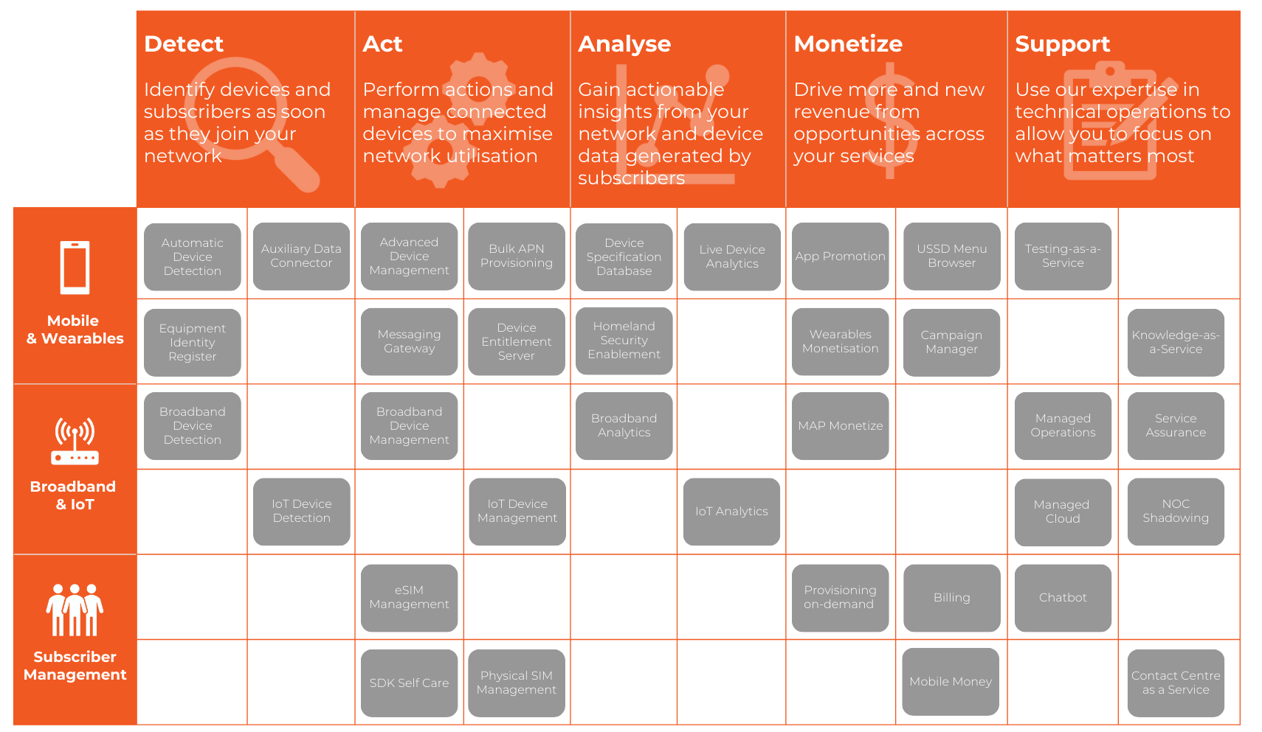

Slide 11
Solution Overview
2024/03/15

Slide 12
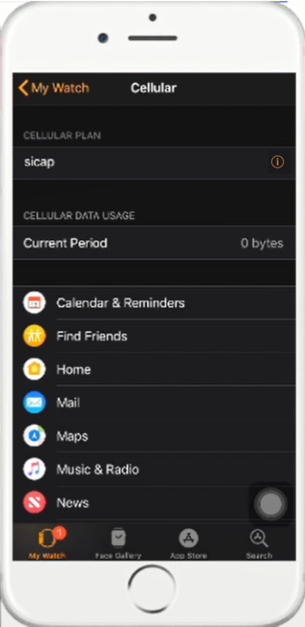
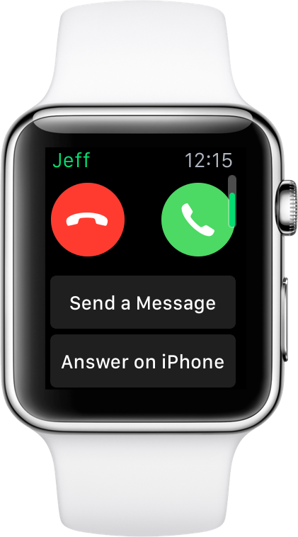
Device Entitlement Server (DES)
DES controls subscribers' access to CSP’s advanced IMS services.
Account Transfer
Enabling seamless transfer of eSIM accounts from old primary/secondary device to new primary/secondary device.
eSIM Watch Pairing
Orchestrating profile download onto eSIM wearable devices
Users can easily pair wearables with their phones and enjoy all the features.
VoLTE
Voice over Long-Term Evolution (VoLTE)
Faster call connect time
HD Voice calls with dramatically improved audio quality
No interruption to data traffic during voice calls
VoWiFi
Make & receive calls over Wi-Fi network connections
Dramatically improves in-building network coverage for Telcos
Leveraging Wi-Fi network saves cost for Telcos
2024/03/15

Slide 13
Key Features
Automated Device Entitlement
DES entitles the device over the air and empowers subscribers to use the services they are entitled to.
Automatic entitlement of IMS services: VoLTE, VoWiFi, One Number
Allows self-registration, for Smartwatches or VoWiFi for instance with built-in Websheets.
Dynamic Roaming Partner preference configuration for Apple device users.
Real-time Detection & Recognition
DES performs device and user authentication so that the correct entitlements can be activated.
Loads subscriber information from BSS and Subscriber data systems.
Ensures secured, compliant & ubiquitous access to IMS services
Supports GSMA standards and security methods for authentication (EAP-AKA, OTP, OpenID).
Communicates with trusted MNO core network components (AAA, SM-DP+).
Better Customer Experience
The operator reaps the benefits of DES and end-users enjoy all the mobile features.
Reduces cost in VoLTE remote entitlement, operations and maintenance.
Seamless transfer of eSIM profile to new primary or secondary device.
Simple definition of profiles and rules for differential entitlement of subscribers to IMS services.
DES
2024/03/15

Slide 14
Real-time Analytics
DES provides more than just entitlement. It features a powerful analytics platform to track, monitor and report in real-time.
Includes three pre-built default dashboards:
Number of entitlements.
Devices identified on the platform.
Subscriber Information.
Ability to share reports and export in multiple formats.
Based on Kibana and Elasticsearch to deliver accurate and flexible reporting.
2024/03/15

Slide 15
The Impact of DES
With DES
Without DES
Seamless transfer of eSIM profile to new primary or secondary device.
Users unable to transfer eSIM profiles to primary and secondary devices when upgrading devices = Not Happy!
IMS services entitlements are differentiated. Subscription plans are up-to-date and configured Over The Air (OTA) for subscribers.
Differentiated IMS service entitlement not possible.
Remote OTA update of roaming partner preference configuration for Apple devices.
Dynamic Roaming partner preference configuration for Apple device users not possible as per Apple standard.
Entitlement of OneNumber use case and pairing of companion devices with smartphone to get access to calls on watch without the need of a Phone nearby.
OneNumber user case support (same phone number on Phone and Smart Watch) not possible on eSIM equipped Wearable / Companion devices like smartwatches.
2024/03/15

Slide 16
CSP Benefits
Speed-up Go-To-Market
For new VoLTE Smartphones and Smartwatches
Save Costs
Through simplifying the entitlement of IMS services
Boost Wearable Adoption
With standards-based entitlement
Grow ARPU
Paired Smartwatch subscriptions leading to recurring revenue growth
Improved Experience
Offer customers a smooth transfer of subscription to eSIM based primary devices
2024/03/15

Slide 17
Technical Stack
Device Entitlement Server relies on state-of-the-art technology to ensure that it is continuously up-to-date, innovative and have robust capabilities.
Database
PostgreSQL
Big data
Elasticsearch
Big data analytics
Kibana
Language
Java 17
Backend framework
Sprint Boot
Frontend framework
Angular
2024/03/15

Slide 18
Technical Overview
Cloud
DES
Entitlement Server
On-Premise
AAA
Devices automatically request IMS service entitlement
Integration to IMS network, eSIM Provisioning and BSS Subscriber Information
BSS/CRM
Devices Entitlement Server delivers latest entitlements instantly
RSP
SM-DP+
Apple, TS.43, Samsung companion device protocols, ACCM REST APIs
Primary and Companion Devices
2024/03/15

Slide 19
Use Cases
2024/03/15

Slide 20
Apple Use Cases - Connectivity
Apple Tethering
Entitlement for personal hotspot, allowing Internet connectivity to be shared with other devices.
Apple Preferred Roaming Network List
Entitlement Server stores and configures the preferred roaming network list which includes the MNC & MCC and activates Data Roaming to select the best roaming plan.
Apple VoLTE
Entitlement for VoLTE, allowing high-speed wireless communication for voice connectivity.
Apple iMessage/FaceTime Activation
Entitlement Server provides activation for iMessage and FaceTime services. Communication is between Entitlement Server and Apple Servers, so SMS is not required.
Apple VoWiFi
Entitlement for Voice over WiFi, allowing users to make and receive calls using a WiFi connection. Especially useful in weak signal areas.
2024/03/15

Slide 21
Apple Use Cases – Watches and Transfer
Apple Watch One-Number
Allowing the subscriber to make and receive calls, messages and much more on their Watch using the Apple primary device MSISDN number.
Apple Watch One-Click Transfer
Allowing the subscriber to transfer One-Number to a new Apple Watch using the iPhone, the old Apple Watch is then disconnected from the network.
Apple Watch Family Setup
Setup multiple Watches for the family using the primary iPhone. Each Watch can make and receive calls using their own number and account.
Apple iPhone One-Click Transfer
Allowing the subscriber to transfer the physical SIM or eSIM account from the old iPhone to the new iPhone with eSIM, the old iPhone account is then deactivated.
Apple iPad Data Plans (Roadmap)
Allowing the subscriber to easily select and activate a data-only eSIM on their iPad.
2024/03/15

Slide 22
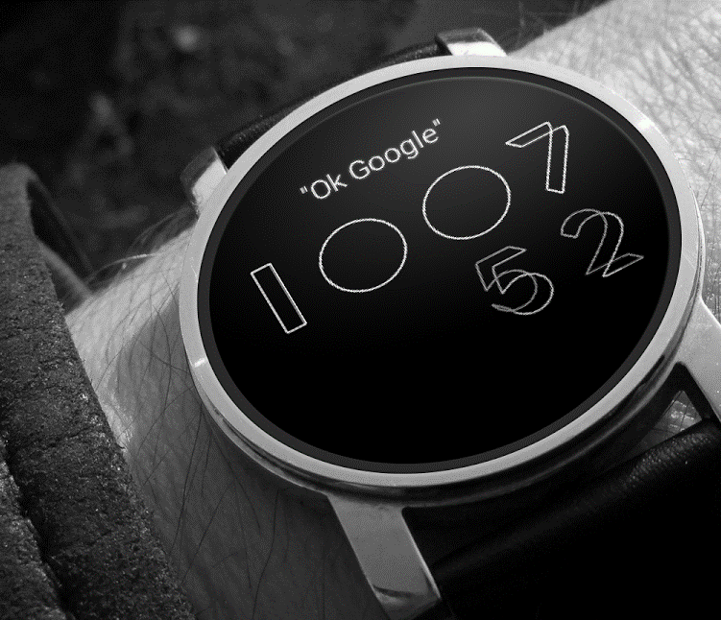
Samsung Companion Device Use Cases
(with proprietary Samsung companion device entitlement protocol)
Samsung Companion Devices Shared Number
Allowing the subscriber to make and receive calls, messages and much more on their Smartwatch using the Samsung primary device MSISDN number.
Samsung Companion Device Different Number
Setup a different MSISDN to the Primary Samsung Device MSISDN for the Smartwatch.
2024/03/15

Slide 23
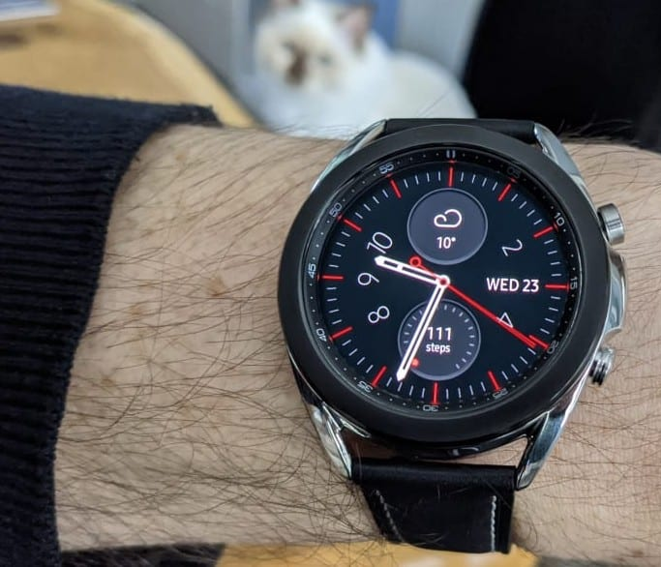
TS.43 ODSA Secondary Device Use Cases
Companion Devices Shared Number
Allowing the subscriber to make and receive calls, messages and much more on their compatible Smartwatch using the primary Android device MSISDN number.
Companion Devices Different Number
Setup a different MSISDN to the Primary Android Device MSISDN for the compatible Smartwatch.
2024/03/15

Slide 24
Apple iPhone One-Click Transfer (Demo)

Slide 25
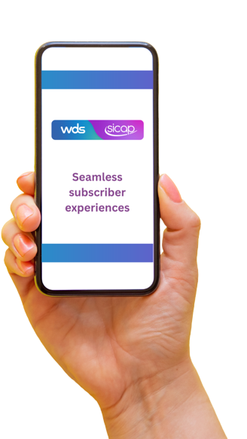
Apple Use Case 1
IMS Service Entitlement for iPhone
Apple iOS includes a proprietary framework for managing entitlements. A carrier bundle, with DES details, is deployed regularly by Apple to all iPhones of the operator.
Subscriber swaps the SIM card and/or powers up the iPhone.
iPhone registers on IMS network.
iPhone sends a request to DES to get latest up-to-date. network IMS services entitlement (VoLTE, VoWiFi, Tethering, Preferred Roaming network).
DES sends to the iPhone latest IMS services entitlement.
Optional: Subscriber agrees to Terms and Conditions, if needed.
Subscriber can now use IMS services.
2024/03/15

Slide 26
Apple Use Case 2
IMS “push” update for iPhone
DES can use Apple Push Notification Services (APNS) to force iPhone to get latest entitlement.
Operator updates IMS services entitlement profile on DES.
DES pushes a notification to the iPhone through Apple APNS .
iPhone sends a request to DES to get latest up-to-date IMS services entitlement.
DES sends to the iPhone latest IMS services entitlements.
Optional : Subscriber agrees to Terms and Conditions, if needed.
Subscriber can now use IMS services as per the allowed. Entitlement.
2024/03/15

Slide 27
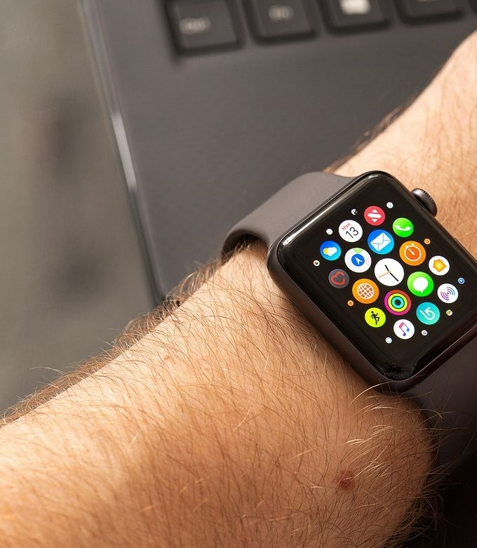
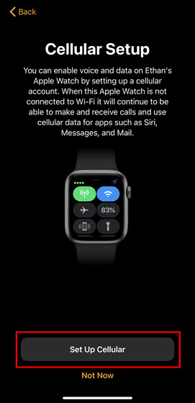
Apple Use Case 3
Apple Watch Cellular Setup
DES entitles an Apple Watch to use IMS services via iPhone paired through Bluetooth.
Subscriber pairs iPhone and Watch (Bluetooth).
Subscriber opens Apple Watch Application.
Subscriber taps “Setup Cellular”.
iPhone securely connects to DES.
DES checks if user is entitled to “Cellular Watch” Bundle Option.
If yes, Subscriber accepts T&C and activates plan option.
DES requests the SM-DP+ server to release an eSIM profile.
DES informs iPhone to start eSIM profile download on the watch.
Apple Watch downloads and installs the profile from SM-DP+.
2024/03/15

Slide 28
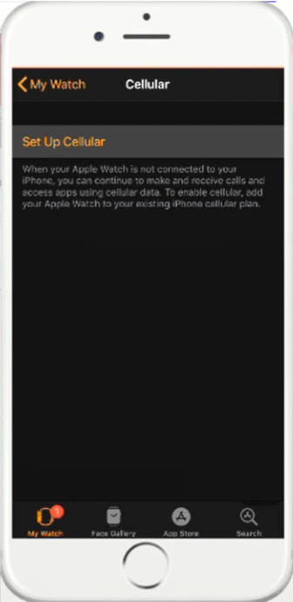
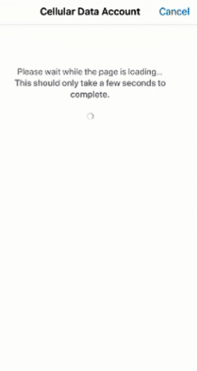
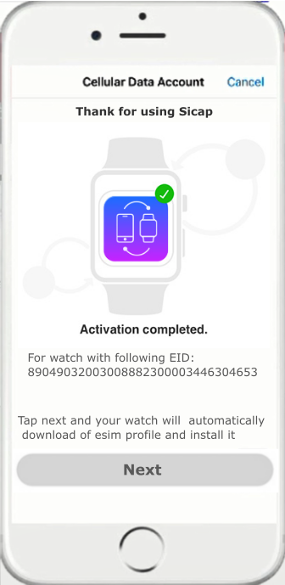
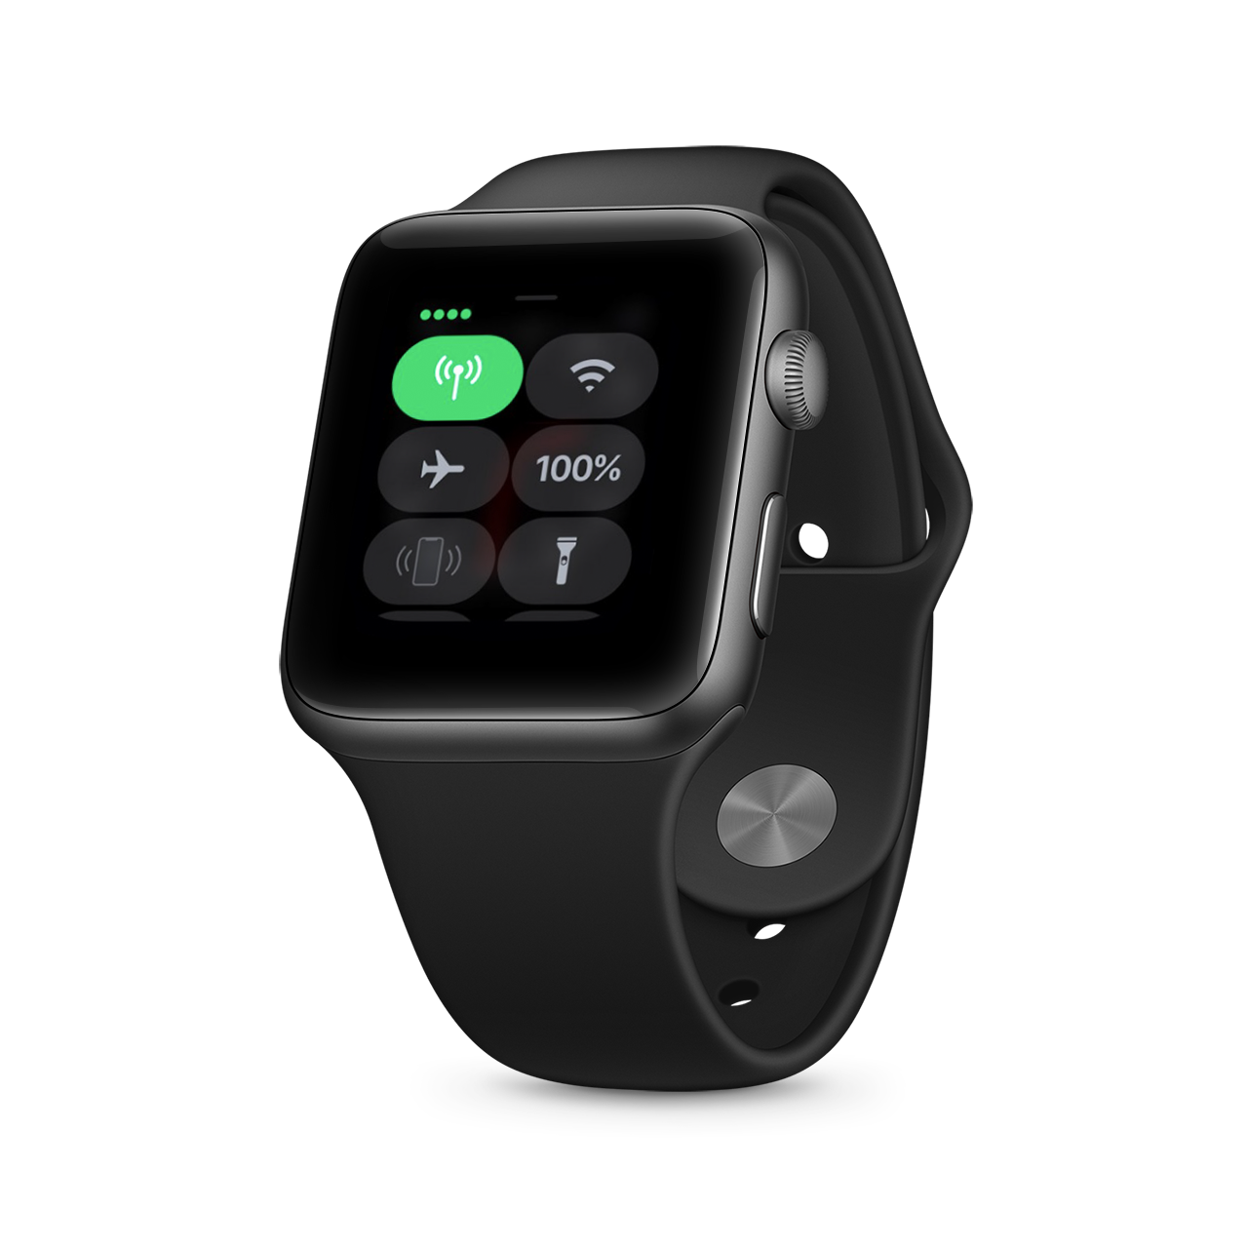
Apple Use Case 3
Apple Watch Cellular Setup: User Perspective
Subscriber buys a new Apple Watch
User downloads Apple Watch App
User pairs his watch with device through Bluetooth
User can immediately setup their watch cellular connection
User can also setup later through Apple Watch app cellular menu
eSIM profile is installed on watch automatically
Watch can now connect to mobile network.
2024/03/15

Slide 29
Apple Use Case 3
Apple Watch entitlement work-flow
Watch
iPhone
DES
SM-DP+
WEBSHEET
Bluetooth pairing
Apple Watch App: Tap Setup Cellular
Checks Entitlements to activate services
Subscription Display & Selection
T&C and price plans presented
T&C and price plans accepted by the user
eSIM Profile Selection Request
New eSIM Profile Allocation
Download allocated eSIM Profile
Profile Download Complete
Watch can use
IMS Services
2024/03/15

Slide 30
Apple Use Cases: Network integration
IMS services entitlement with Apple specifications
SM-DP+
ES2+
Operator systems
APNS
Apple Service
HTTPS
LRF
Location resource function
HTTPS
DES Websheet
AAA
Subscriber authentication
Authentication
EAP-AKA
DIAMETER
Get Entitlements
HTTPS
BSS
Subscriber information
IMS services entitlements
DES
BSS subscriber information
REST API
or
CSV upload from DES UI
2024/03/15

Slide 31
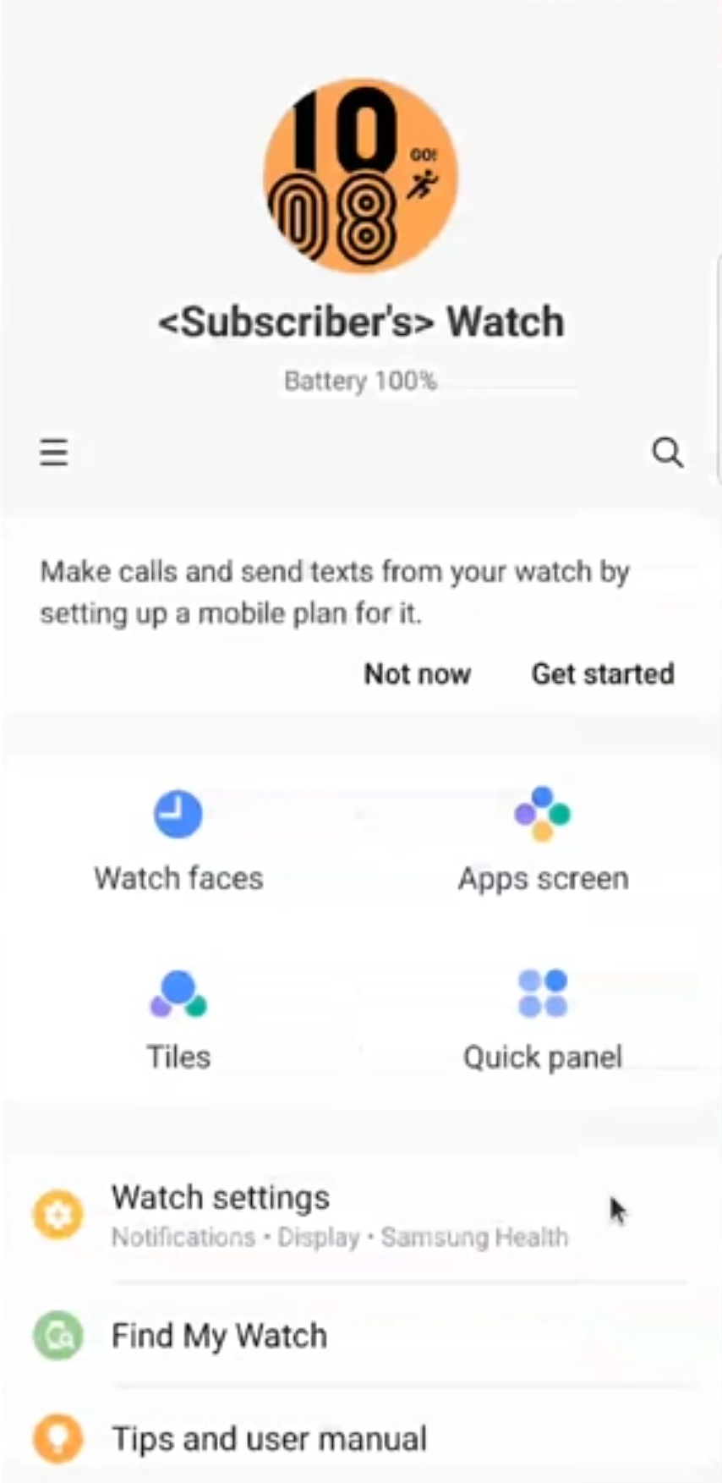
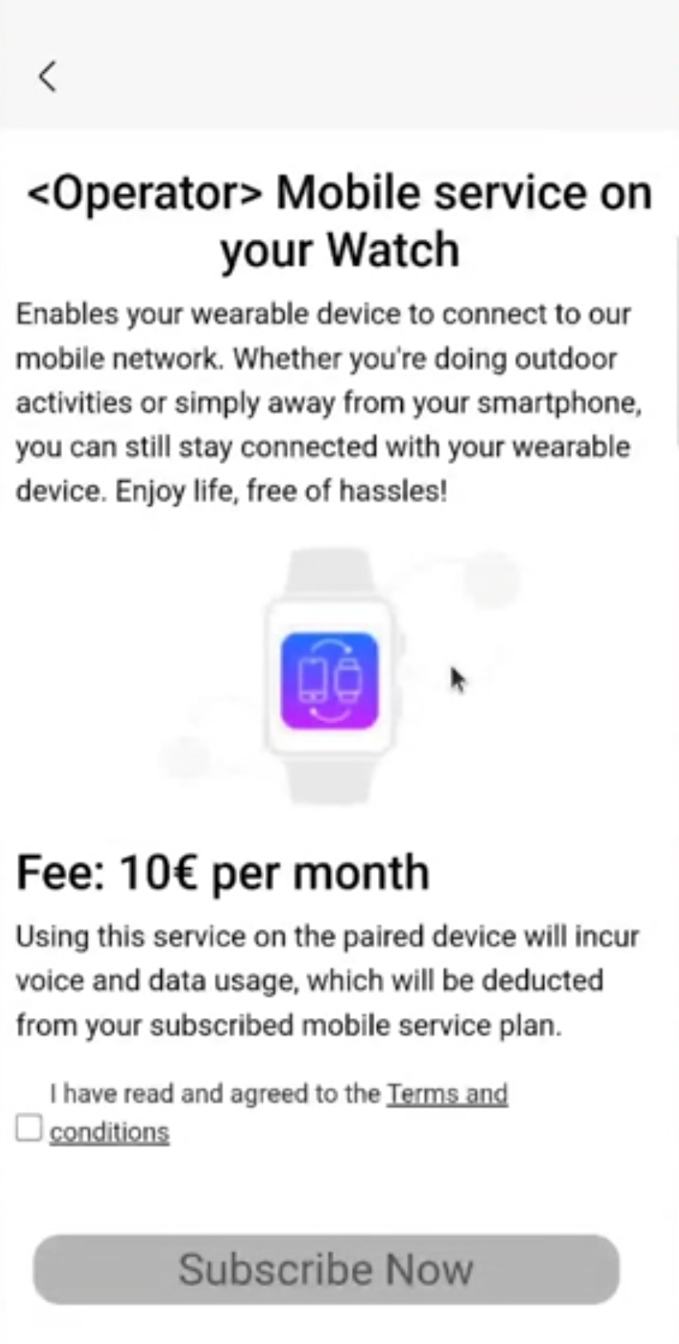
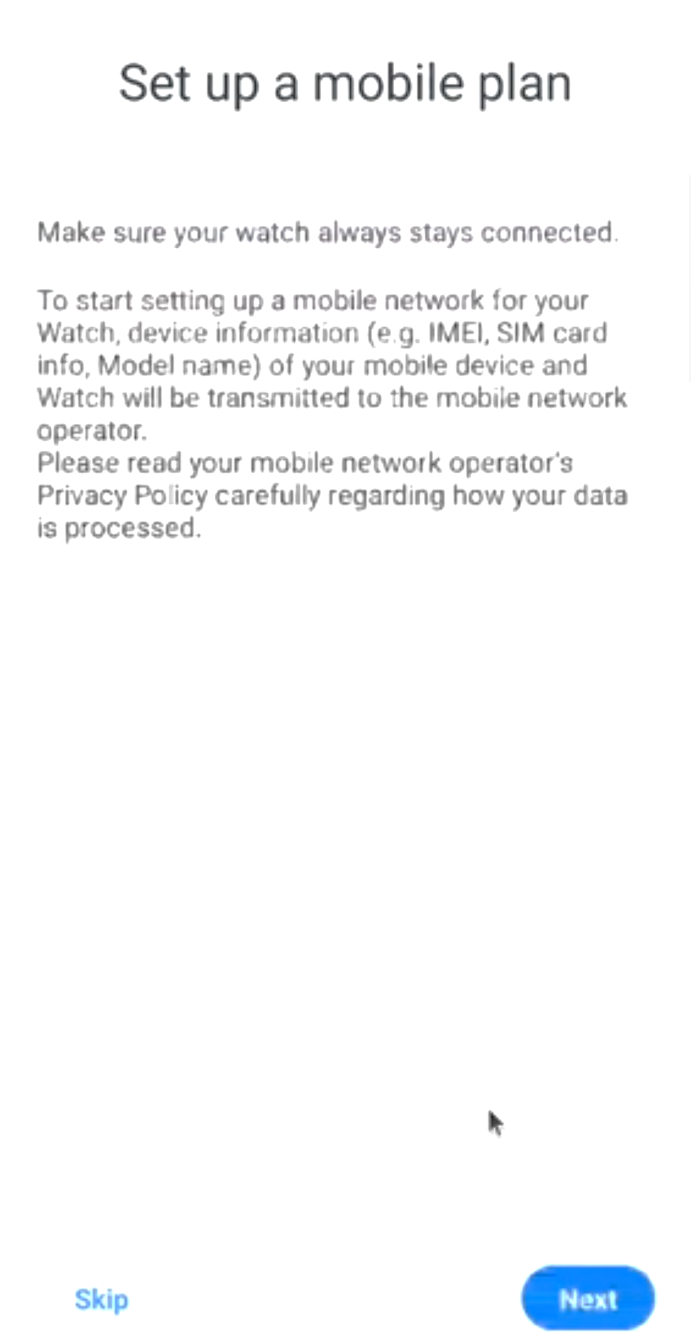
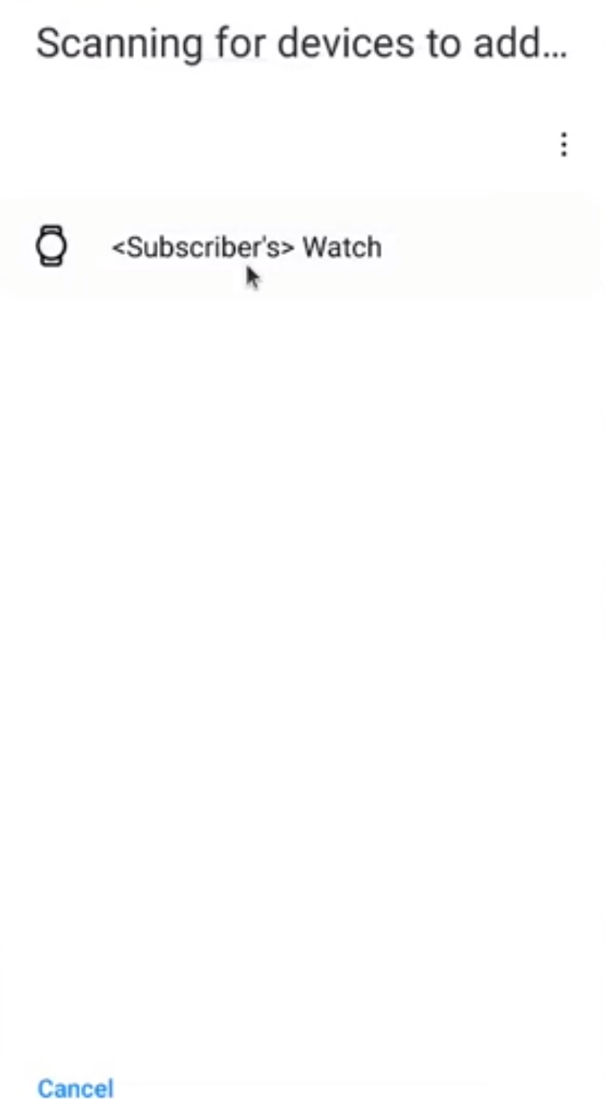
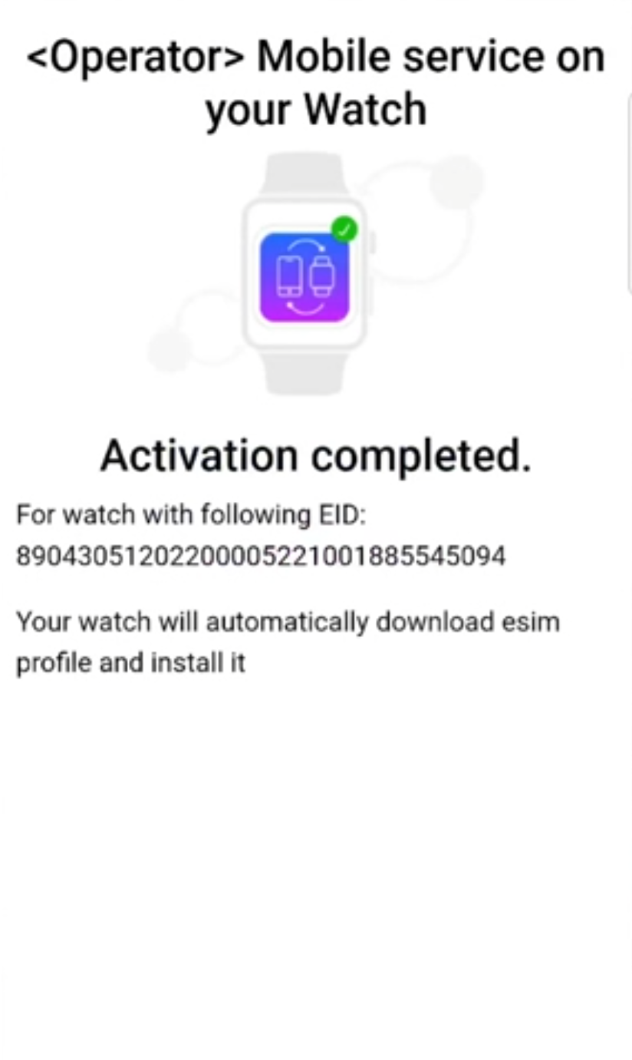
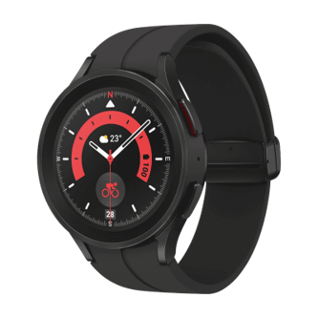
Samsung Use Case
Samsung Watch Cellular Setup: User Perspective
Subscriber buys a new Samsung Watch
User downloads and runs Galaxy Wearable App
User pairs his watch with device through Bluetooth
User can immediately setup their watch cellular connection
2024/03/15
2024/03/15

Slide 32
TS.43 VoWiFi USE CASE: Network integration
IMS services entitlement with GSMA TS.43 specifications
Operator systems
HTTPS
LRF
Location resource function
HTTPS
(Optional)
(Optional)
DES Websheet
AAA
Subscriber authentication
Authentication
EAP-AKA
DIAMETER
Get VoWiFi Entitlements
HTTPS
BSS
Subscriber information
VoWiFi entitlement response
BSS subscriber information
REST API
or
CSV upload from DES UI
DES
2024/03/15

Slide 33
TS.43 VoWiFi USE CASE
Entitlement work-flow
Device
DES
AAA Server
LRF
Entitlement Request for VoWiFi with EAP-AKA Authentication (EAP_ID)
AAA Authentication
Successful AAA Authentication
Response with entitlement status for VoWiFi (ap2004)
Request for Websheet (T&C and Emergency Address)
Websheet (T&C and Emergency Address)
User agrees to T&C and provides valid emergency address
Entitlement Request with Token
Entitlement Response with updated status for T&C and Emergency Address
2024/03/15

Slide 34
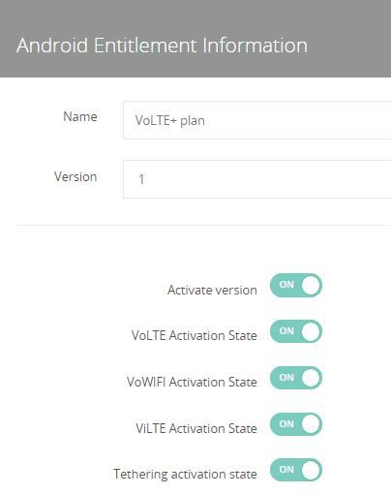
Tackling Android Entitlements
With the ACCM App
We developed the Carrier Configuration Manager or ACCM app to bring entitlement capabilities to phones running Android OS version 6 or higher.
Dynamic entitlement: Support for automated differential entitlement for different subscriber profiles
Support for operator driven entitlement profile change: DES pushes, over Firebase Cloud Messaging. The operator-initiated changes in entitlement profile to the right Android devices.
Security: Privilege to provide this configuration is given only to applications signed by the carrier.
Defined API: Utilizes documented carrier config API in Android 6.0 and above.
Application must be signed with the certificate that has a matching signature to one on the SIM.
Available entitlements:
VoLTE, ViLTE, VoWiFi, Tethering
Note: devices to be entitled shall be ready to support IMS features provided by the Operator and should have been preconfigured to access provider's IMS network. Devices that do not support IMS features and without IMS APN cannot be entitled.
2024/03/15

Slide 35
Android Use Case
IMS services provisioning with ACCM application
Thanks to Android Carrier Configuration Manager API, it is possible to entitle and change IMS service entitlements of the phone.
ACCM application (Standalone or module integrated in Carrier application) is installed on the phone. It runs on the background.
Subscriber swaps the SIM card and/or powers up the android phone.
ACCM application sends a request to DES to get latest up-to-date IMS services entitlements.
DES authenticates and validates the subscriber.
DES sends to the ACCM application latest IMS services entitlements.
Optional : Subscriber agrees to Terms and Conditions, if needed.
ACCM application activates IMS services via Android CCM API.
Subscriber can use entitled IMS services.
2024/03/15

Slide 36
Thank you!
Questions?
2024/03/15

